Slide 1
Introduction to Parallel Programming with MPI

Slide 2
Distributed memory computers
Distributed memory computers cannot communicate through a shared memory.
Therefore, messages are used to coordinate parallel tasks that eventually run on geographically distributed but interconnected processors.
Processes as well as their management and communication are well defined by a platform-independent message passing interface (MPI) specification.
MPI is introduced from the practical point of view, with a set of basic operations that enable implementation of parallel programs.
We will give simple example programs that will serve as an aid for a smooth start of using MPI and as motivation for developing more complex applications

Slide 3
Distributed memory computers
Distributed Memory Computers Can Execute in Parallel
two main differences between the shared memory and distributed memory computer architectures
Price of communication: the time needed to exchange a certain amount of data between two or more processors is in favor of shared memory computers, as these can usually communicate much faster than the distributed memory computers.
Number of processors: that can cooperate efficiently, is in favor of distributed memory computers.

Slide 4
Distributed memory computers
our primary choice when computing complex tasks will be to engage a large number of fastest available processors,
but the communication among them poses additional limitations.
When the number of processors must be high (e.g., more than eight) to reduce the execution time, the speed of communication becomes a crucial performance factor.
There is a significant difference in the speed of data movement between two computing cores within a single multi-core computer, depending on the location of data to be communicated. This is because the data can be stored in registers, cache memory, or system memory, which can differ by up to two orders of magnitude if their access times are considered.

Slide 5
Distributed memory computers
The differences in the communication speed get even more pronounced in the interconnected computers, again by orders of magnitude, but this now depends on the technology and topology of the interconnection networks and on the geographical distance of the cooperating computers.
Complex tasks can be executed efficiently either
(i) on a small number of extremely fast computers or
(ii) on a large number of potentially slower interconnected computers.

Slide 6
Enable MPI in Visual Studio
Download MPI for Windows(Microsoft MPI)
https://www.microsoft.com/en-s/download/details.aspx?id=57467
Run both .exe and .msi file, they will install Microsoft MPI under C:\Program Files\Microsoft MPI by default.(But if you have changed the register manually, the path might be changed)

Slide 7
Configure MPI in Visual Studio 2019
Open Project -> Project_name Properties
Under VC++ Directories
Add C:\Program Files (x86)\MicrosoftSDKs\MPI\Include in Include Directories
Add C:\Program Files(x86)\MicrosoftSDKs\MPI\Lib\x86 in Library Directories

Slide 8
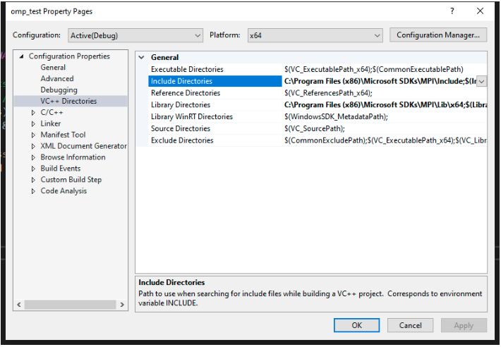
Configure MPI in Visual Studio 2019

Slide 9
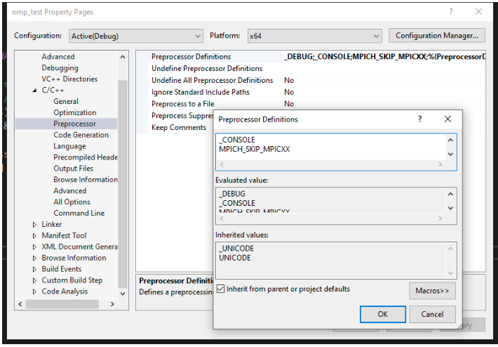
Configure MPI in Visual Studio 2019
In C/C++ -> Preprocessor -> Preprocessor Definitions
Add MPICH_SKIP_MPICXX

Slide 10
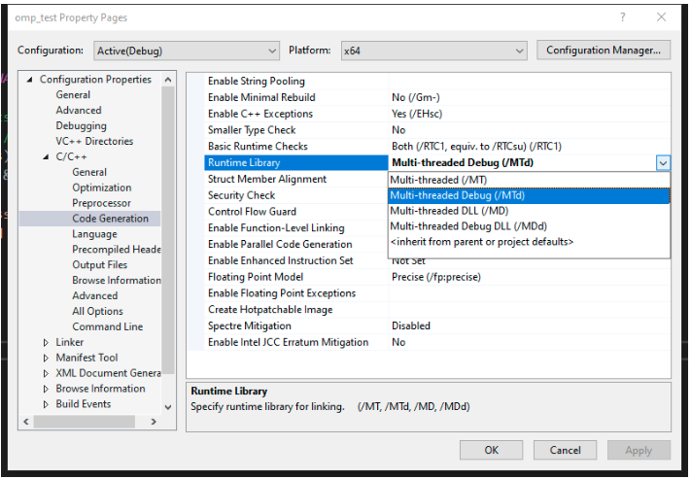
Configure MPI in Visual Studio 2019
In C/C++ -> Code Generation
Change Runtime Library to MTd

Slide 11
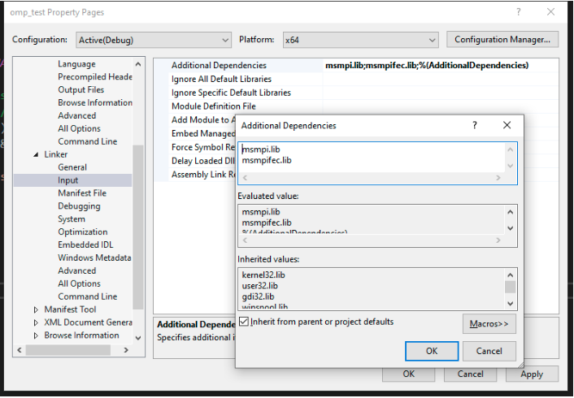
Configure MPI in Visual Studio 2019
In Linker -> Input -> Additional Dependencies
Add msmpi.lib and msmpifec.lib

Slide 12
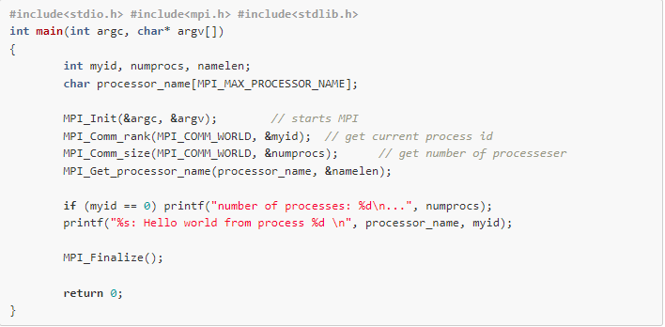
Testing
Click Build -> Build Solution
And your terminal will looks like the following screenshot.
Please make sure you can build .exe file successfully without error.
You can see the .exe file path inside the terminal, for me, it is
E:\TestingPrograms\omp_test\x64\Debug\omp_test.exe

Slide 13
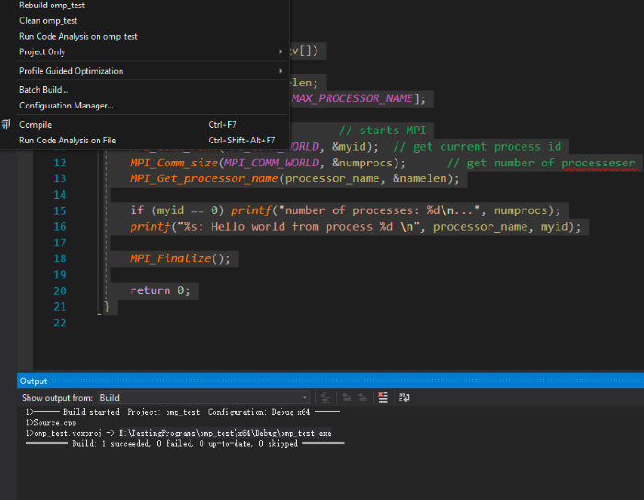
Testing
Open file explorer, E:\TestingPrograms\omp_test\x64\Debug\ folder (Your path will be different!)
Do right-click while pressing Shift button

Slide 14
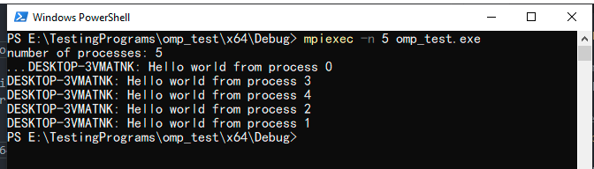
Testing
Enter mpiexec -n 5 omp_test.exe in powershell or command-line window(depend on your Windows version, for Win10 you will see powershell, but for early version you will see command-line)
You can replace 5 with number of process you want,
omp_test.exe must be replaced by the name of your builded .exe file
https://610yilingliu.github.io/2020/07/21/ConfigureOpenMPI/

Slide 15
Message Passing Interface (MPI)
Enables system independent parallel programming.
The MPI standard includes process creation and management, language bindings for C and Fortran, pointtopoint and collective communications, and group and communicator concepts.
Programmers have to be aware that the cooperation among processes implies the data exchange.
The total execution time is consequently a sum of computation and communication time.
Algorithms with only local communication between neighboring processors are faster and more scalable than the algorithms with the global communication among all processors.
Therefore, the programmer’s view of a problem that will be parallelized has to incorporate a wide number of aspects, e.g., data independency, communication type and frequency, balancing the load among processors, balancing between communication and computation, overlapping communication and computation, synchronous or asynchronous program flow, stopping criteria, and others.

Slide 16
Message Passing Interface (MPI)
The MPI is not a language
All MPI “operations” are expressed as functions, subroutines, or methods
The MPI standard defines the syntax and semantics of library operations that support the message passing model, independently of program language or compiler specification.
An MPI program consists of autonomous processes that are able to execute their own code in the sense of multiple instruction multiple data (MIMD) paradigm.
An MPI “process” can be interpreted in this sense as a program counter that addresses their program instructions in the system memory, which implies that the program codes executed by each process have not to be the same.

Slide 17
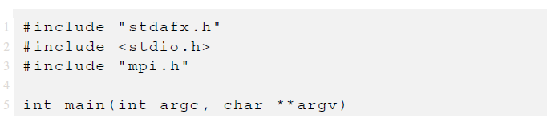
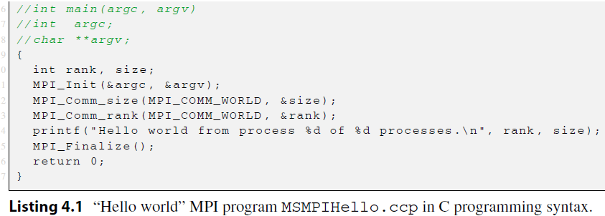
Message Passing Interface (MPI)
Notes:
calls
to global MPI operations that are executed on all processes.

Slide 18
Message Passing Interface (MPI)
#include "stdafx.h" is needed because the MS Visual Studio compiler has been used,
#include <stdio.h> is needed because of printf, which is used later in
the program, and
#include "mpi.h" provides basic MPI definition of named constants, types, and function prototypes, and must be included in any MPI program.

Slide 19
Message Passing Interface (MPI)
The number of processes will be determined by parameter -n of the MPI execution utility mpiexec, usually provided by the MPI library implementation.
MPI_Init initializes the MPI execution environment and
MPI_Finalize exits the MPI.
MPI_Comm_size(MPI_COMM_WORLD, & size) returns size, which is the number of started processes.
MPI_Comm_rank(MPI_COMM_WORLD, & rank) that returns rank, i.e., an ID of each process.
MPI operations return a status of the execution success; in C routines as the value of the function, which is not considered in the above C program, and in Fortran routines as the last argument of the function call

Slide 20
Message Passing Interface (MPI)
The “Hello World” code in Listing 4.1 is the same for all processes
It has to be compiled only once to be executed on all active processes
Run the program with:
$ mpiexec -n 3 MSMPIHello
from Command prompt of the host process, at the path of directory where MSMPIHello.exe is located
The program should output three “Hello World” messages, each with a process identification data.
All non-MPI procedures are local, e.g., printf in the above example
It runs on each process and prints separate “Hello World” notice
If one would prefer to have only a notice from a specific process, e.g., 0, an extra if(rank == 0) statement should be inserted.
Note also that in this simple example no communication between processes has been required.

Slide 21
MPI Operation Syntax
The MPI standard is independent of specific programming languages.
Capitalized MPI operation names will be used in the definition of MPI operations
MPI operation arguments, in a language-independent notation, are marked as:
IN—for input values that may be used by the operation, but not updated;
IN arguments are in normal text, e.g., buf, sendbuf, MPI_COMM_WORLD, etc.
OUT—for output values that may be updated by the operation, but not used as input value;
OUT arguments are in underlined text, e.g., rank, recbuf, etc.
INOUT—for arguments that may be used and/or updated by the MPI operation.
INOUT arguments are in underlined italic text, e.g: inbuf, request, etc.

Slide 22
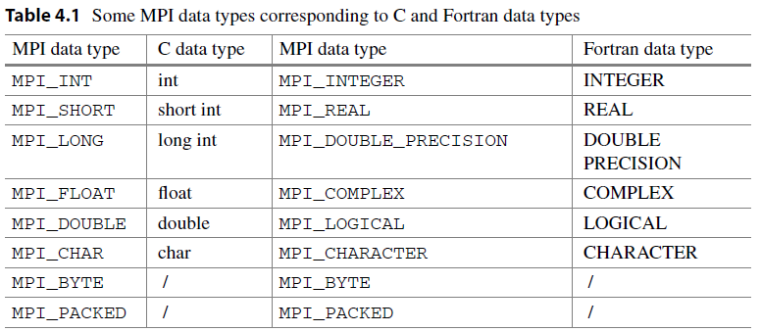
MPI Data Types
The type MPI_PACKED is maintained by MPI_PACK or MPI_UNPACK operations, which enable to pack different types of data into a contiguous send buffer and to unpack it from a contiguous receive buffer

Slide 23
MPI Data Types
A value of type MPI_BYTE consists of a byte, i.e., 8 binary digits
A byte is uninterpreted and is different from a character
Different machines may have different representations for characters or may use more than one byte to represent characters
On the other hand, a byte has the same binary value on all machines. If the size and representation of data are known, the fastest way is the transmission of raw data, for example, by using an elementary MPI data type MPI_BYTE.
The MPI communication operations have involved only buffers containing a continuous sequence of identical basic data types. Often, one wants to pass messages that contain values with different data types, e.g., a number of integers followed by a sequence of real numbers; or one wants to send noncontiguous data, e.g., a subblock of a matrix. The type MPI_PACKED is maintained by MPI_PACK or MPI_UNPACK operations, which enable to pack different types of data into a contiguous send buffer
and to unpack it from a contiguous receive buffer

Slide 24
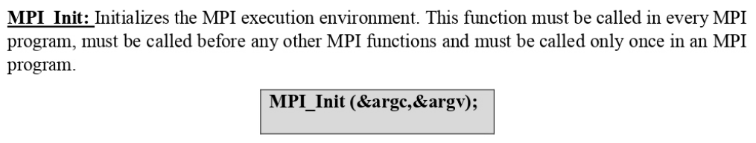
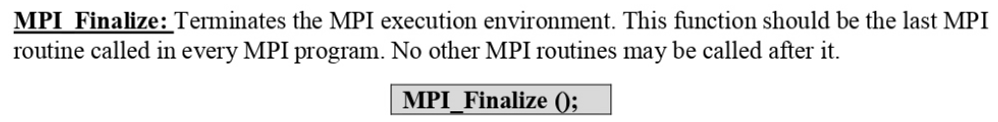
Notes:
The arguments argc and argv are required in C language binding only, where they are parameters of the main C program.
No MPI routine can be called before MPI_INIT or after MPI_FINALIZE, with one exception MPI_INITIALIZED (flag), which queries if MPI_INIT has been called.

Slide 25
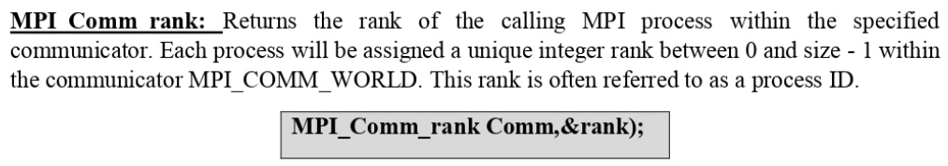
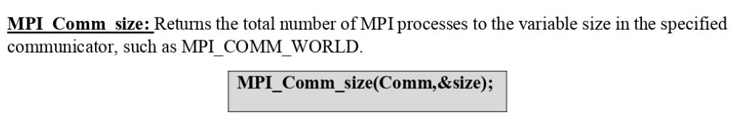

Slide 26
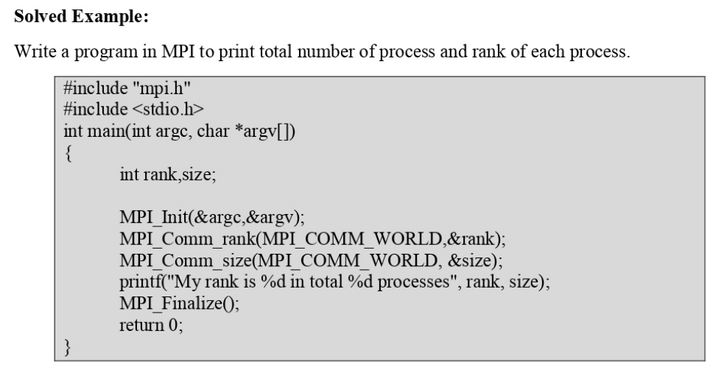

Slide 27
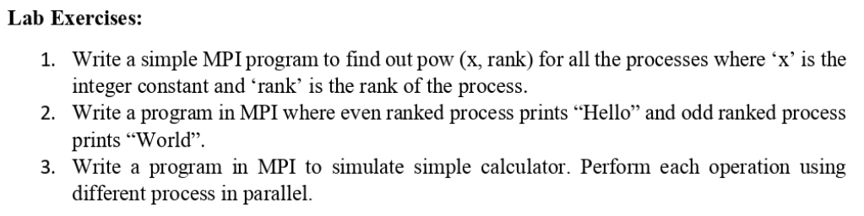
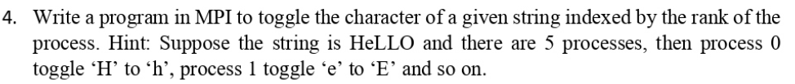

Slide 28

The process-to-process communication has to implement two essential tasks:
data movement and
Synchronization of processes;
Therefore, it requires cooperation of sender and receiver processes.

Slide 29
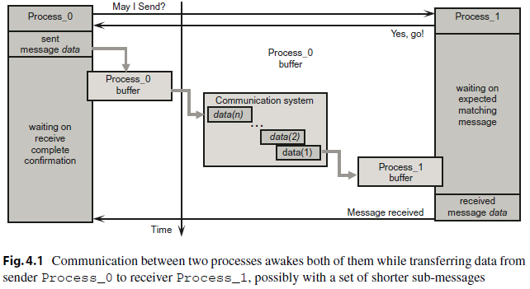

Slide 30
Optional intermediate message buffers are used in order to enable sender Process_0 to continue immediately after it initiates the send operation.
However, Process_0 will have to wait on the return from the previous call, before it can send a new message.
On the receiver side, Process_1 can do some useful work instead of idling while waiting on the matching message reception.
It is a communication system that must ensure that the message will be reliably transferred between both processes.
If the processes have been created on a single computer, the actual communication will be probably implemented through a shared memory.
If the processes reside on two distant computers, then the actual communication might be performed through an existing interconnection network using, e.g., TCP/IP communication protocol.
Although that blocking send/receive operations enable a simple way for synchronization of processes, they could introduce unnecessary delays in cases where sender and receiver do not reach communication point at the same real time.
For example, if Process_0 issues a send call significantly before the matching receives call in Process_1, Process_0 will start waiting to the actual message data transfer. In the same way, processes’ idling can happen if a process that produces many messages is much faster than the consumer process. Message buffering may alleviate the idling to some extent, but if the amount of data exceeds the capacity of the message buffer, which can always happen, Process_0 will be blocked again.

Slide 31
The next concern of the blocking communication are deadlocks.
For example, if Process_0 and Process_1 initiate their send calls in the same time, they will be blocked forever by waiting matching receive calls.

Slide 32
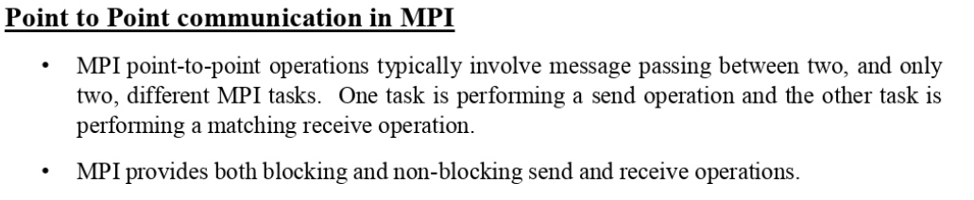
MPI_SEND (buf, count, datatype, dest, tag, comm)
The send buffer is specified by the following arguments
buf - pointer to the send buffer,
count - number of data items,
datatype - type of data items.
The receiver process is addressed by an envelope that consists of arguments
dest, which is the rank of receiver process within all processes in the communicator comm, and of a message tag.
tag provide a mechanism for distinguishing between different messages for the same receiver process identified by destination rank

Slide 33
MPI_RECV (buf, count, datatype, source, tag, comm, status)
This operation waits until the communication system delivers a message with matching datatype, source, tag, and comm.
The entire set of arguments: count, datatype, source, tag and comm, must match between the sender process and the receiver process to initiate actual message passing.
When a message, posted by a sender process, has been collected by a receiver process, the message is said to be completed, and the program flows of the receiver and the sender processes may continue.

Slide 34
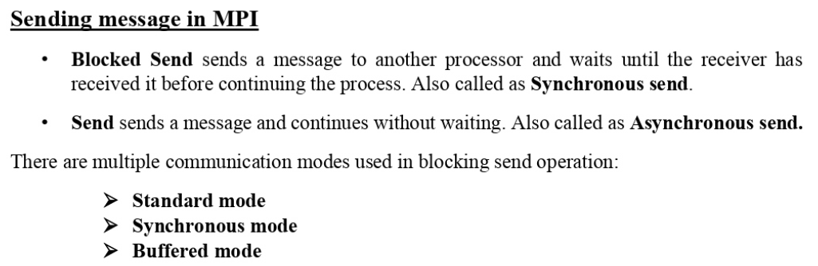

Slide 35
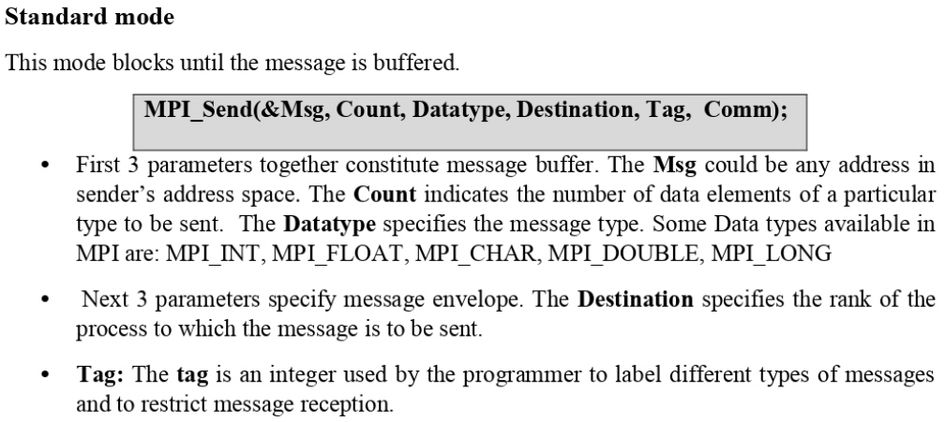

Slide 36
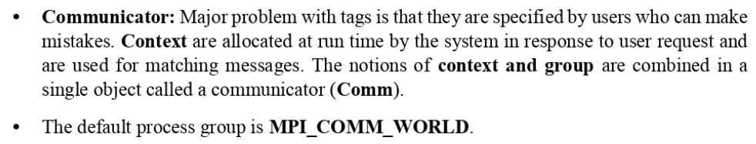

Slide 37
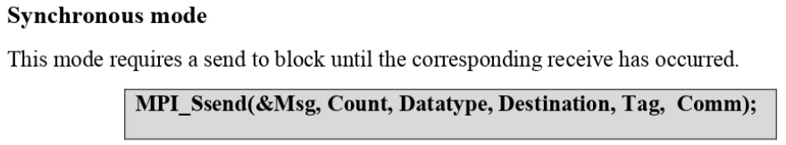
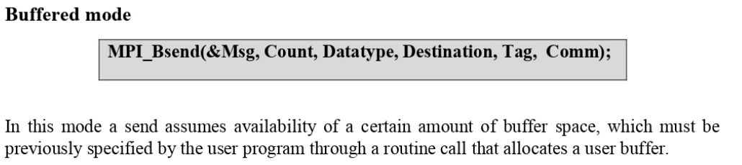

Slide 38
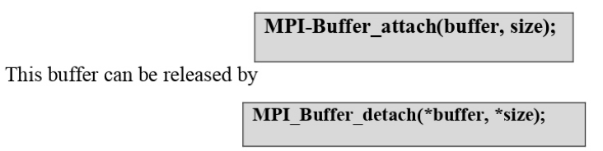

Slide 39
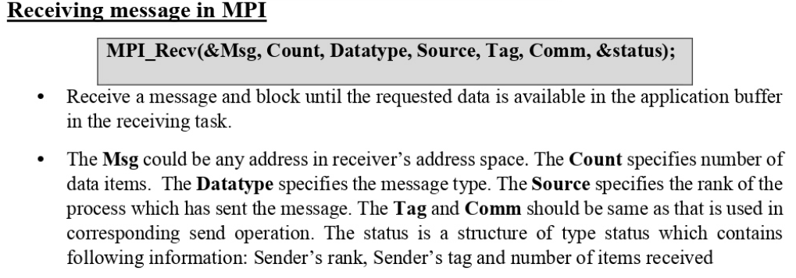

Slide 40
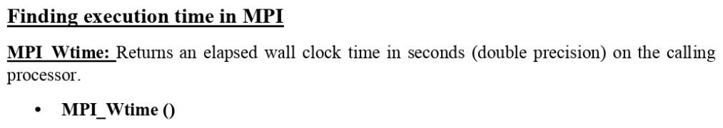
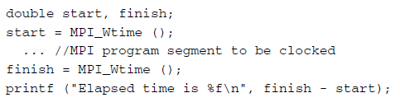

Slide 41
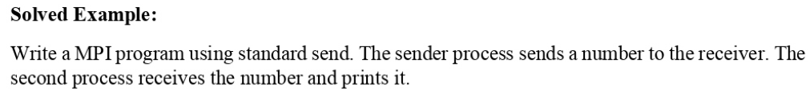
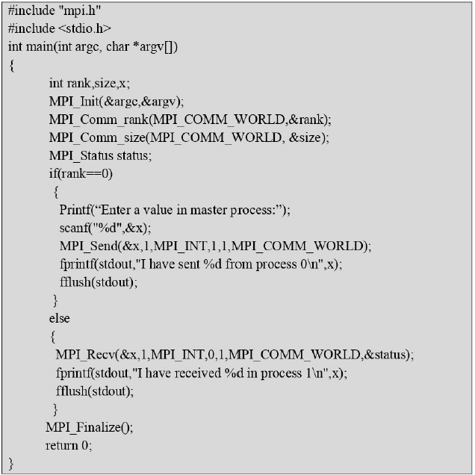

Slide 42
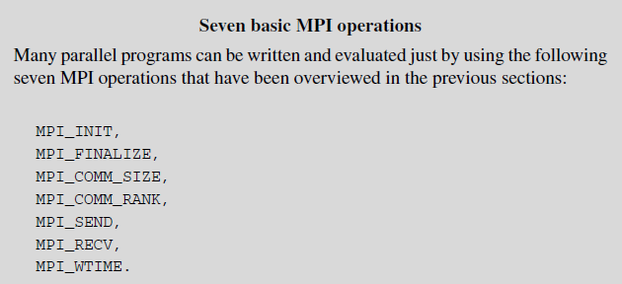

Slide 45
Basic MPI Operations

